Slide 1
Pixel Props
Steven Keyes and Becca Greene

Slide 2
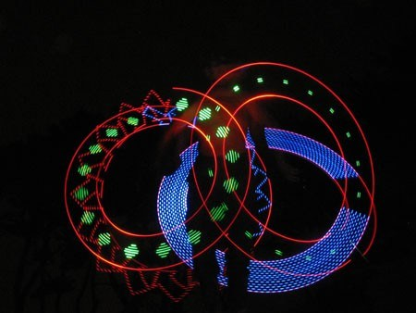
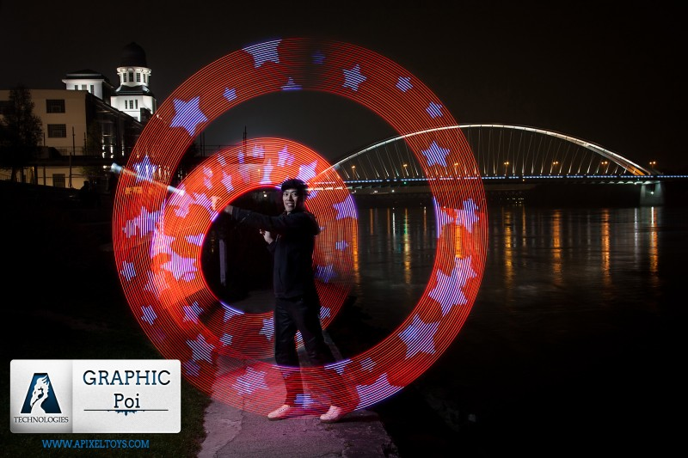
Notes:
From: http://hackadaycom.files.wordpress.com/2008/08/poiplay.jpg?w=450&h=338
And apixeltoys.com

Slide 3
Design – board
Xbee Radio
32 bit STM microcontroller
WS2811-based LED strip
(individually addressable)
Gyro
(digital, 3 axis)
Accelerometer
(digital, 3 axis)

Slide 4
Design – board
Xbee Radio
32 bit STM microcontroller
WS2811-based LED strip
(individually addressable)
MPU6050 IMU (digital, 6 axis)

Slide 5
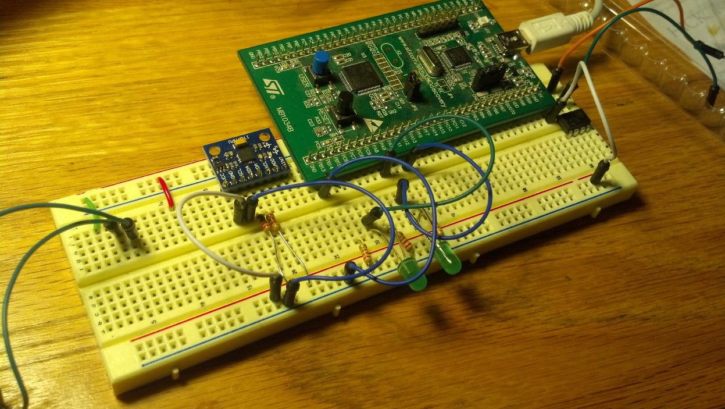
Progress
Ordering parts
Debugging and programming ICs
STM Demo Board

Slide 6
Budget
Category | Item | Cost ($)
 | Prototype components | 50
Poi | LEDs | 90
 | ICs | 40
 | Batteries | 15
 | Casing | 15
Staff | LEDs | 90
 | ICs | 20
 | Batteries | 10
 | Casing | 20
Wireless stuff |  | 100
Board manufacturing |  | 500

Slide 7
Budget – details
Item | Cost ($)
Accelerometer | 9
Microcontroller | 6
LED strips (per meter) | 33

Slide 8
Timeline
November
Spec and choose parts
Order parts for testing
December
Test circuitry on breadboard and write code that implements the following
Communication with with gyro, accelerometer, and LEDs
Basic dynamics calculations
cursedlight library – Zach Banks
Lay out and order board and other final hardware

Slide 9
Timeline
January
Manufacture case
Assemble circuitry
Write code that uses sensor input to drive LEDs in certain patterns
Extra time
Board revisions
Wireless communication

